Slide 1
Real-Time Sentiment Analysis on Twitter to Predict the Cryptocurrency Price
Tong Wu, tw2906,
Yu Wu, yw3748,
Yiqing Cao, yc4138,
Eric Chang, cc4900

Slide 2
Background
Price is the visualisation of demand-supply relationship model
Demand and supply depends on many, ranging from government policies to the buying and selling behavior of individuals
These information can be concluded as expressions of sentiment
Intuitionally, people analysis sentiment from information to predict the price
Social media like twitter contains large amount of sentiment
Notes:
In a market economy, goods and services have prices because resources are limited, and the price of a given good or service depends on demand and supply, in other words, price is the visualization of demand-supply relationship model, these are the two basic principles of economics. The factors that can influence demand and supply are many, ranging from government policies to individual buying and selling behavior. These information can be summarized as an expression of sentiment toward a good or service. Intuitionally, people using the information they can gather to analyze sentiment in order to predict prices. And now, with the rapid growth of the Internet, we can get news and people's opinions from social media. This makes gathering information more quickly. However, we need the help of an algorithm to quickly analysis the sentiment on social media to determine the likely price trend. That's why we chose this topic, which is to help predict cryptocurrency prices by analyzing sentiment in real time.

Slide 3
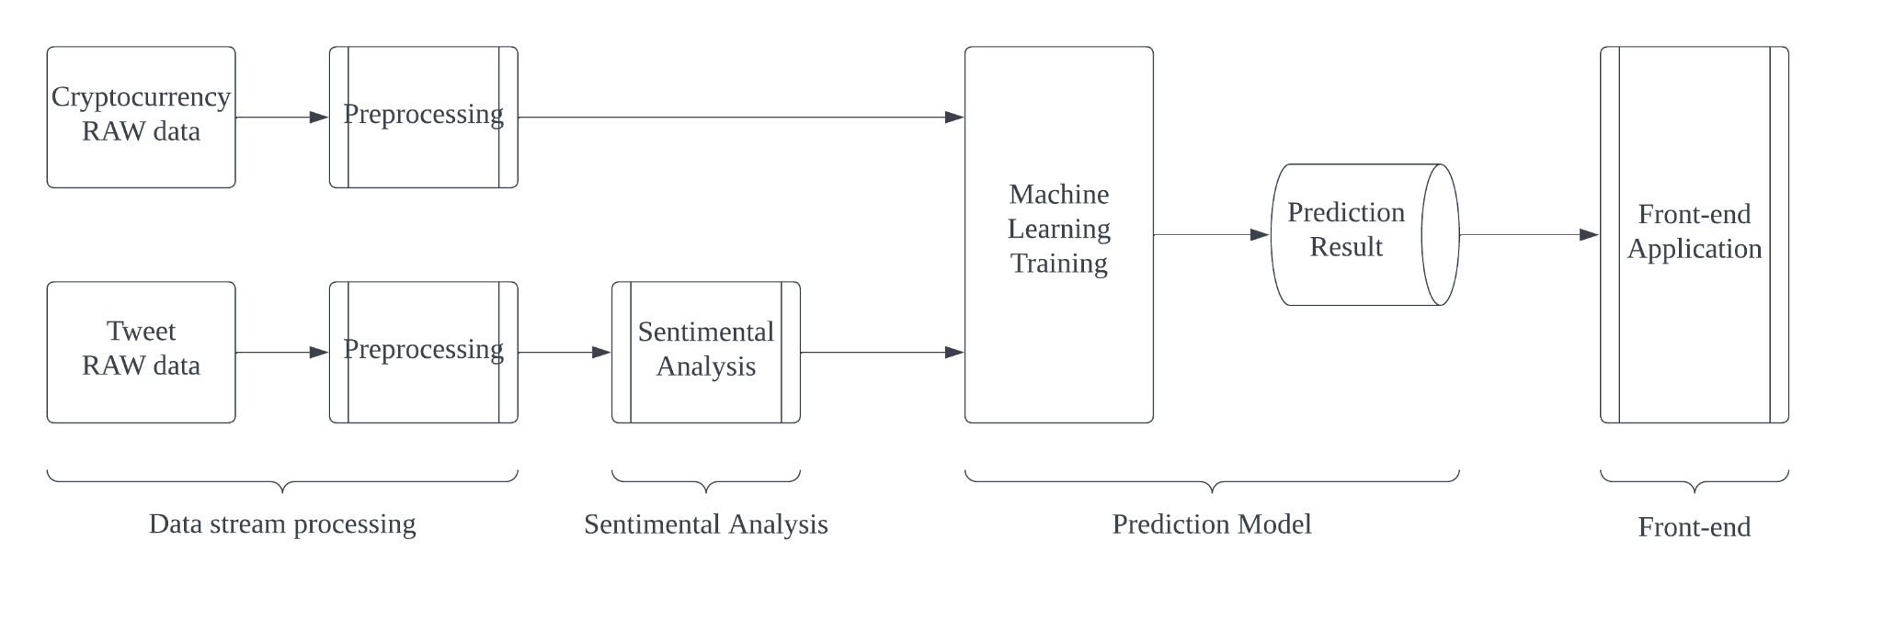
Introduction
Notes:
In order to analyze sentiment to predict cryptocurrency prices, we divided the pipeline of the project into four main parts: data streaming, sentiment analysis, prediction model and front-end presentation. Our final goal is to provide an online web page to present our model results, including predicted prices and price trend graphs. Next, my teammates and I will go through the pipeline to present each part separately and demonstrate our project.

Slide 4
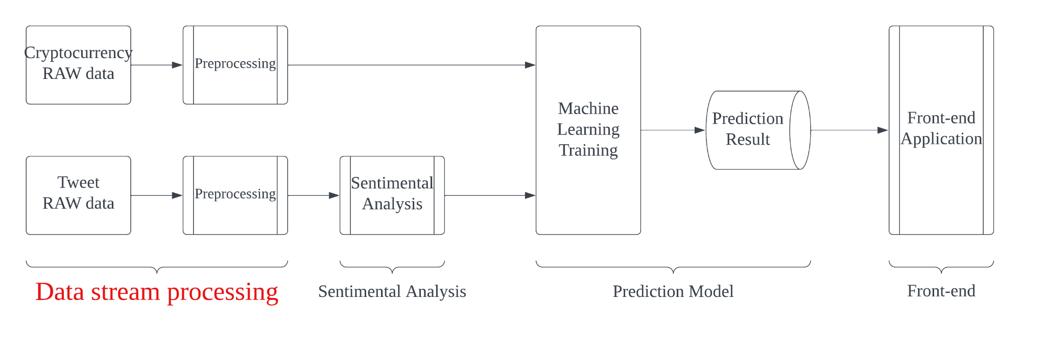
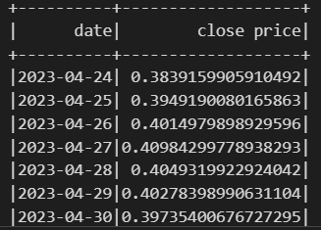
Cryptocurrency data introduction
By using yahoo api: yfinance
Only use daily close price in our system

Slide 5
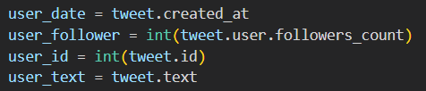
Twitter api introduction
Using twitter api: tweepy
Can only fetch about 10 days data
Testing data: from 2023/4/19 ~ 2023/4/27
Filter method: using tweepy function to search key word:
1
2
Extract data method:

Slide 6
Twitter data introduction
Twitter data summary:
cryptocurrency type | tweet number
Cardano | 2000
Ripple | 2000
Dogecoin | 5000
Bitcoin | 7000
Ethereum | 8000

Slide 7
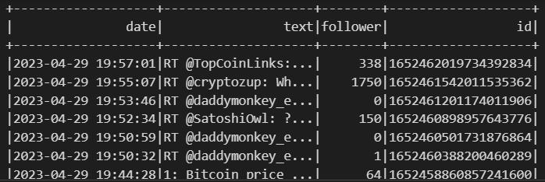
Twitter data introduction
Then feeding twitter data into pyspark dataframe

Slide 8
Twitter data cleaning
Pipeline (all done by pyspark):
remove followers < 10 data
remove retweet
remove emoji
remove links
remove mention
remove space, next line
start sentiment prediction

Slide 9
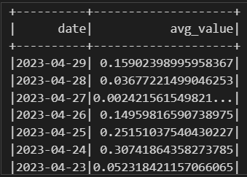
Final result output
avg_value: average sentiment score (will explain more on the following pages)

Slide 10
Stream optimization
Load shedding:
Define own shedding mechanism: Discard data when the units digit of the id is consistent with the number which is randomly generated from 0 to 9
Operator reordering:
Move the highest selectivity operator (“remove followers < 10 data” filter) to the begining

Slide 11
Final stream preprocessing
pipeline
data shedding
remove followers < 10 data
remove retweet
remove emoji
remove links
remove mention
remove space, next line
start sentiment prediction

Slide 12
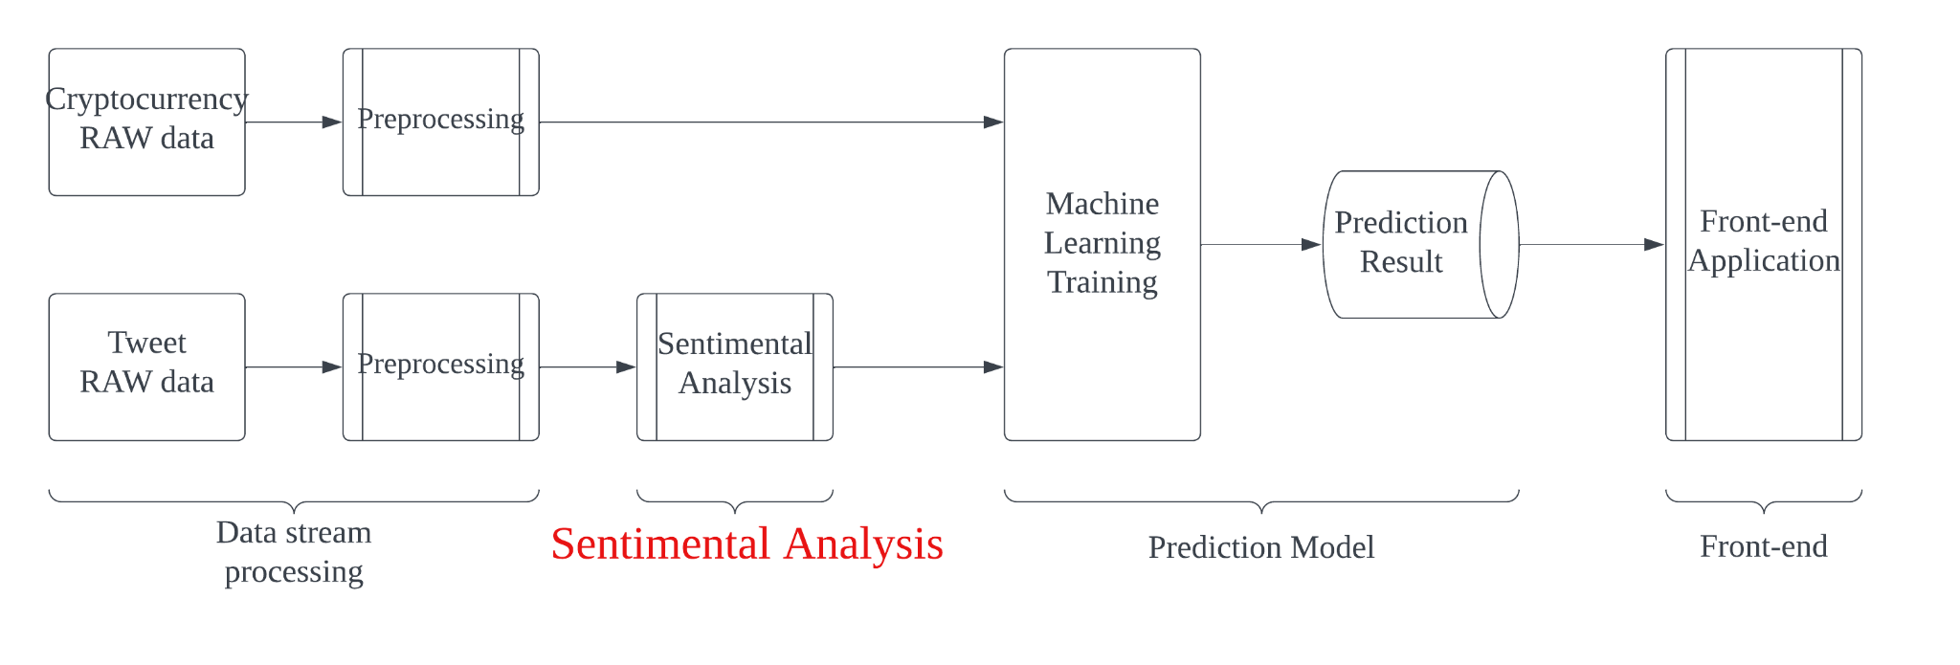
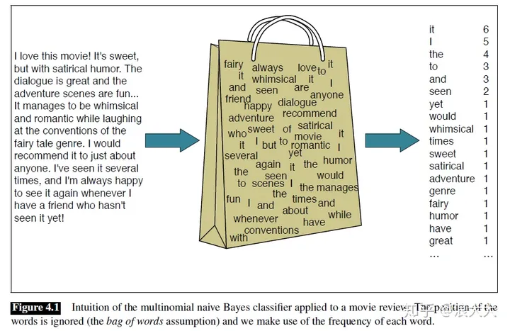
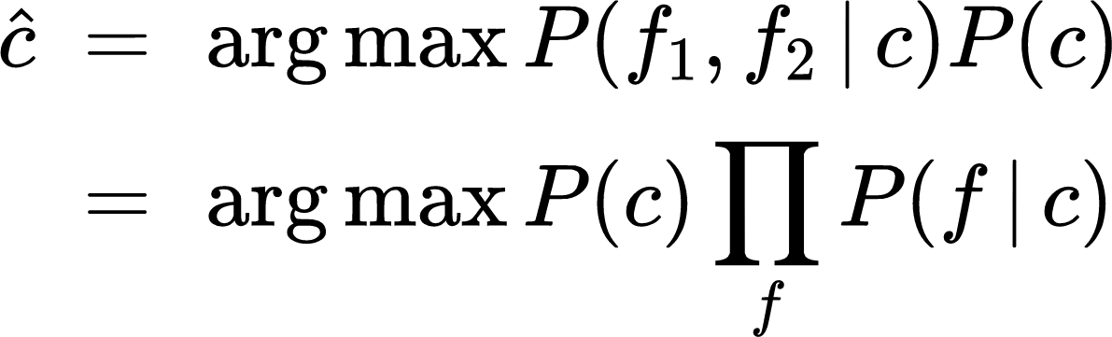

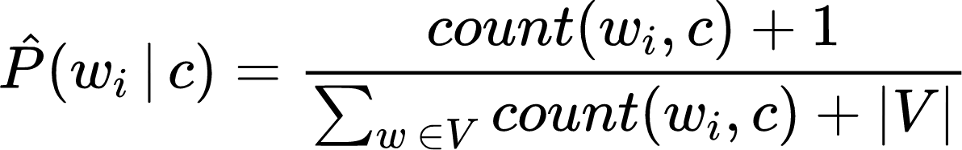
Sentimental Analysis-Naive Bayes
Without loss of generalization, we can represent the document d as a set of features f1, f2…
But since the Naive Bayes plainly multiplies all the characteristic probabilities, a zero probability in the likelihood term of any class will result in a zero probability of the result. The simplest solution is Laplace smoothing.
For document d and all categories c ∊ C, the classifier returns the category with the maximum posterior probability for the given document.

Slide 13
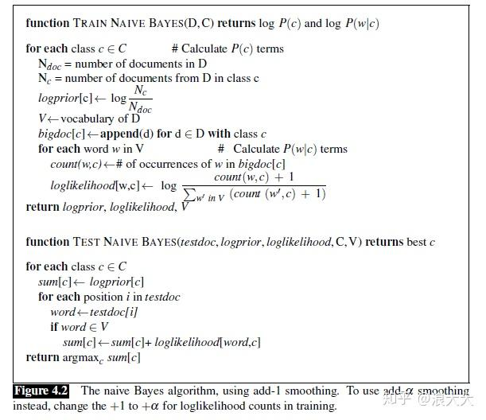
Sentimental Analysis-Naive Bayes
Optimization:
1. Glossary V：For those words that appear in our test data but are not in our vocabulary, and for another category of words: stop words, the solution is to ignore them - to remove them from the test file and not to include any possibility of them at all.

Slide 14
Sentimental Analysis-Naive Bayes
Optimization:
2. A very simple baseline commonly used when dealing with negation in sentiment is to prefix each word after the logical negation symbol (n't, NOT, no, never) with the NOT prefix during text normalization. Thus, newly formed words like NOT_like, NOT_recommend will appear more frequently in negative documents and will serve as cues to negative emotions, while words like NOT_bored, NOT_reject will gain positive associations.

Slide 15
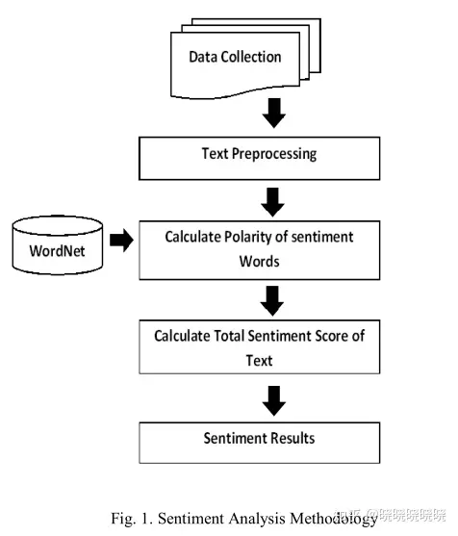
Sentimental Analysis-Lexicon
positive
emotion words
neutral
negative
degree words
negative words

Slide 16
Sentimental Analysis-Lexicon
01
SentiWordNet assigns scores to WordNet synsets instead of words
Each synset has both a positivity and a negativity score, lying between 0 and 1.
SentiWordNet
02
As opposed to SentiWordNet, SentiWords assigns scores directly to words.
This allows us to use this dictionary without having to disambiguate the input text first.
SentiWords
03
VADER is a lexicon and a rule-based sentiment analysis tool for social media text.
It also covers emojis and abbreviations
VADER

Slide 17
Sentimental Analysis
Approach | Naive Bayes | Lexicon
Training Effort | Model is fast to train | Pretrained models are easy and quick to implement
Strength | Computation is fast Custom models | Less resource and computationally intensive Contains linguistic rules that go beyond what is captured in a typical document-term-matrix model.
Weakness | rely on complete and representative dataset | Susceptible to misspelllings, nomenclatures, sarcasm,irony, jargons, and grammatical mistakes as they are notrecognized by the lexicon
Accuracy | 54.23% | 67.43%
✔

Slide 18
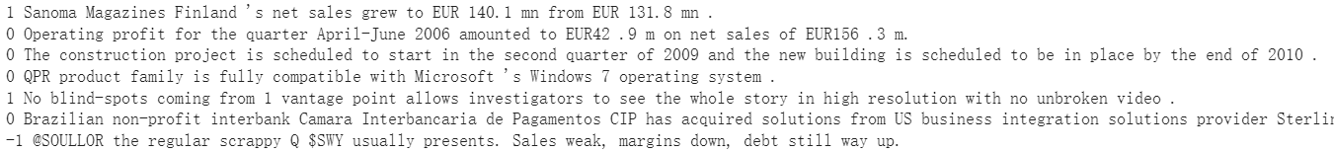
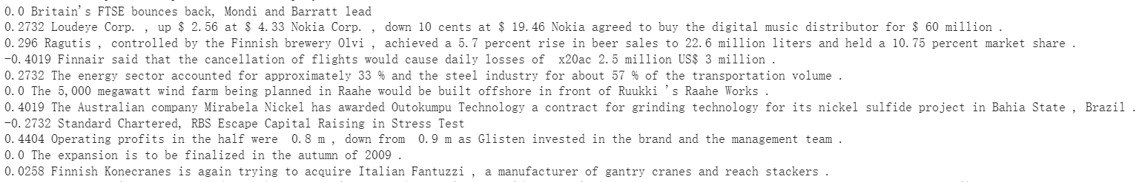
Sentimental Analysis-Result Example
Naive Bayes
Lexicon(Vader)

Slide 19
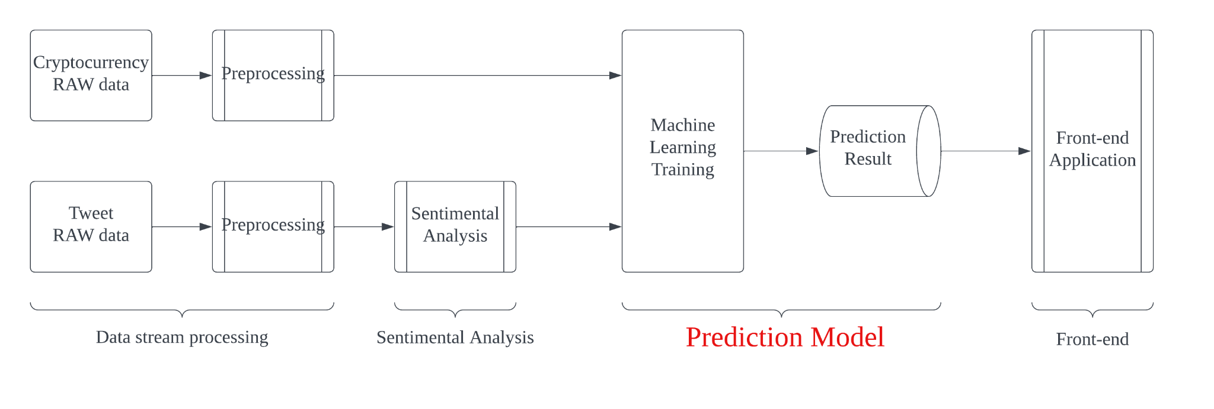
Prediction Model - Overview
Objective:
Find and conclude the potential relationship between price and sentimental value to predict future price trend.
Input:
Preprocessed crypto price data
Sentimental analysised data
Output:
Array of predicted price
Price trend diagram
Notes:
In this part, I will introduce the pipeline of the prediction model, including the model we used, optimizations, prediction function and predicted results. After stream processing and sentimental analysis, the pipeline of the project input two processed dataset into here, and the objective of the prediction model is that to find and conclude the potential relationship between price and sentimental value, even it is obscure. For the prediction model, the input is pre-processed cryptocurrency price data and sentimental values, and the output is the predicted price and price trend graph.

Slide 20
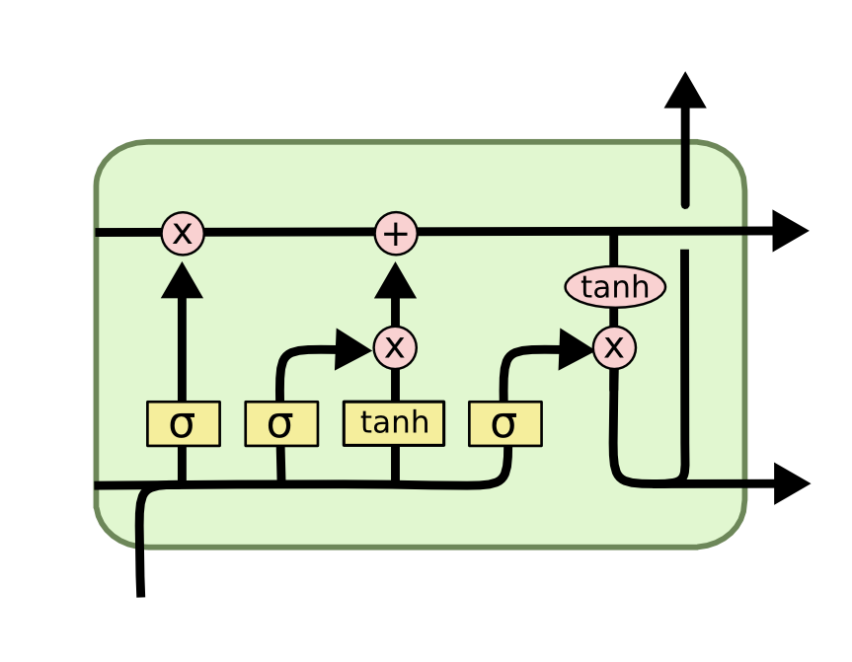
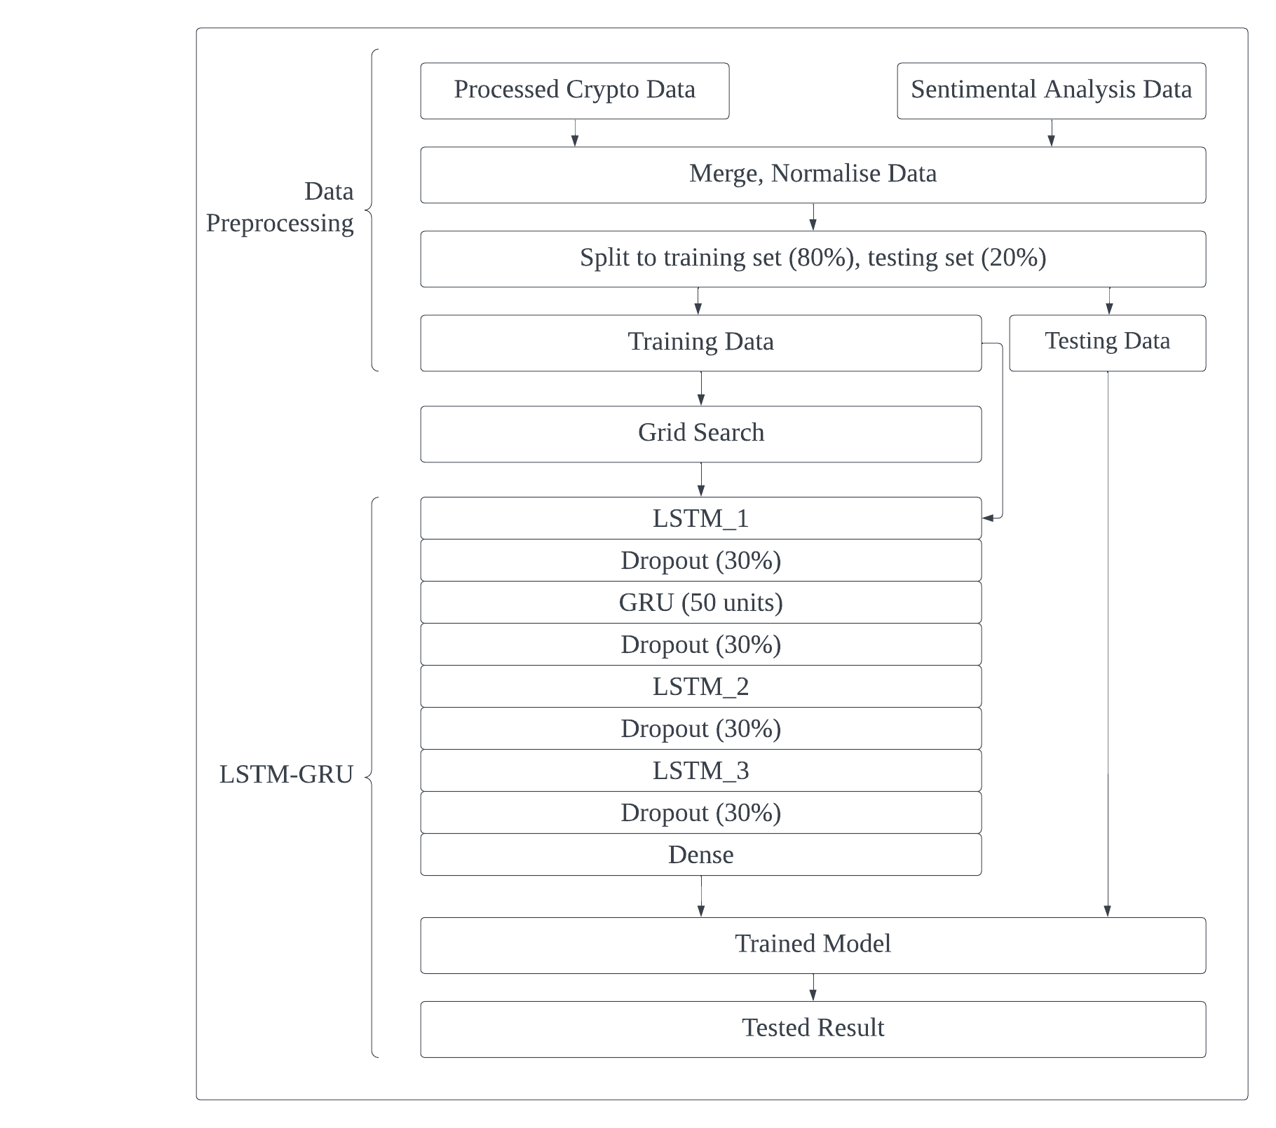
Prediction Model - Structure
Data pre-processing
Grid Search
Hyperparameter tuning
LSTM-GRU model
Time series modeling: memory cell makes the model can learn from current and previous data
Long term dependencies
Adaptive learning
Notes:
I will introduce how we construct the prediction model. The right side graph shows the pipeline of the function that construct the model. First, we need to do some data cleaning for the two input dataset. We need to merge them into one dataset and normalize to ensure it has fixed change range. After that, split the dataset into training set with 80% and test set with 20%. Then, we introduced Grid search, which test all given hyperparameters to calculate the Root Mean Square Error value iteratively, and provide the hyperparameter set which has the best performance. Finally we input the hyperparameter set and training data into the model that we will construct.
We use LSTM-GRU hyper model to predict the price. The model is mainly contain a 3 LSTM layers and 1 GRU layer. The reason that we choose LSTM as the model is that the crypto prices represent time dependencies, meaning that past prices influence future prices. LSTM are naturally suited for handling time series data. LSTM memory cell has input, forget, and output gates that control the flow of information in, retention, and out of the cell, which makes the model can capture the relationship between past information and current input. Also, crypto prices can be affected by long-term trends and sudden events. LSTMs can capture these long-term dependencies, improving the accuracy of the predictions.

Slide 21
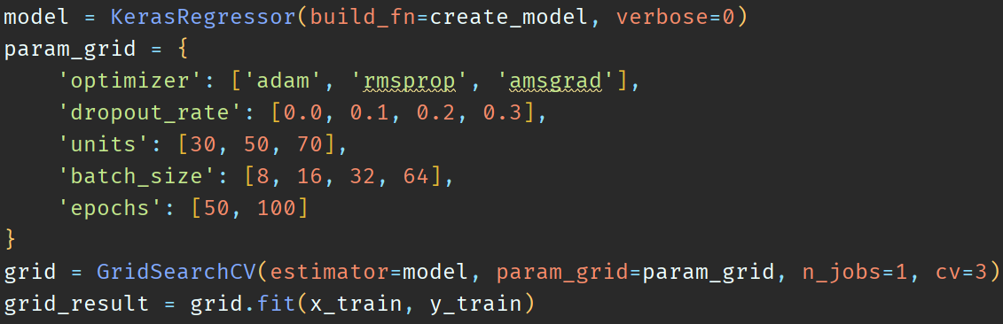
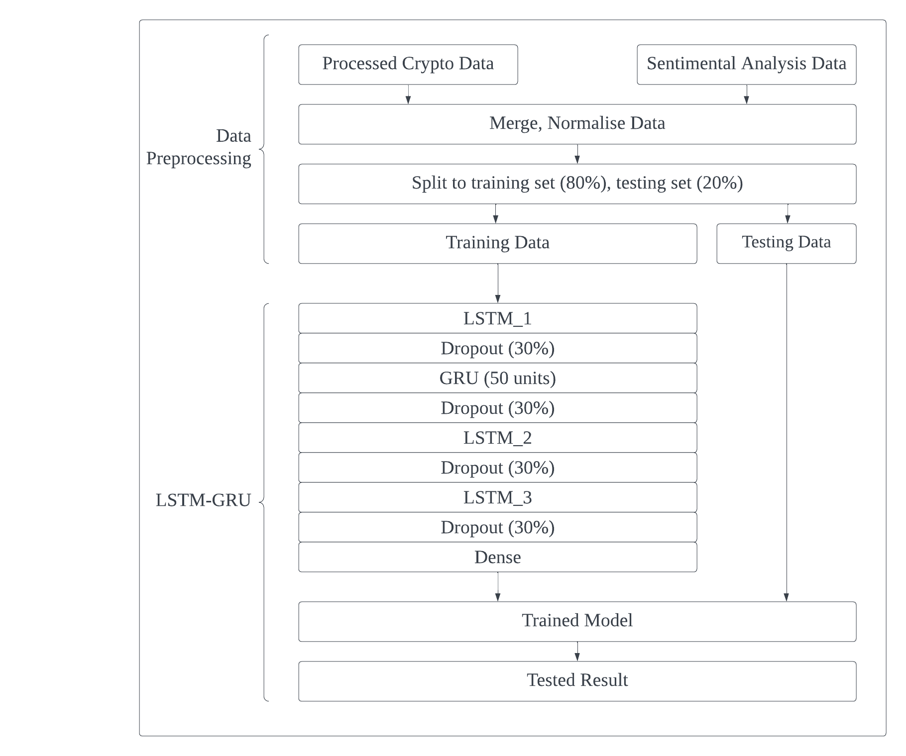
Prediction Model - Optimisation
Grid Search:
LSTM with AMSGard optimiser:
Retains the maximum of all past second moment estimates. Correction factor to ensure the gradient average is not underestimated. Improve model accuracy and rubustness
Dropout:
Randomly discard result from a part of neurals. Mainly improve generalization and avoid over-fit.
GRU:
GRU can capture different characteristics from LSTM, improve accuracy.
Notes:
In training model, the optimizations are essential for the model accuracy and training time. Here I list several ways in which we optimize our model, we significantly increase the generalize ability and robustness of the model to quickly capture the features of the dataset and make predictions.
**Grid Search: **
First is grid search. We train several hyperparameters in the grid model and find the best ones. The grid search is able to determine the accuracy of the model by determining the Root Mean Square Error for each hyperparameter combination.
**AMSGrad:**
Second is AMSGrad, it is a optimizer in neural network. AMSGrad retains the maximum of all past second moment estimates to prevent sudden drops in learning rate, resulting in better optimization performance. Also, it uses a correction factor to ensure the gradient average is not underestimated during the iteration, it in order to get the better convergence performance. In general, AMSGrad has the best performance and robustness in the result from grid search.
**Dropout Layer:**
Third is dropout layer. By adding dropout layers after each LSTM layer of the model to randomly discard the output of a certain percentage of neurons to ensure that the model does not rely excessively on certain neurons. In this model, we set each LSTM layer to have 30% of neurons result will discarded. We found that the addition of the dropout layer significantly increases the generalization ability of the model and prevents overfitting.
**GRU Layer**:
The last one is GRU model. GRU has simpler structure than LSTM, which GRU has only two gates, the update and reset. The different structure makes GRU has faster training time and can capture different features than LSTM.

Slide 22
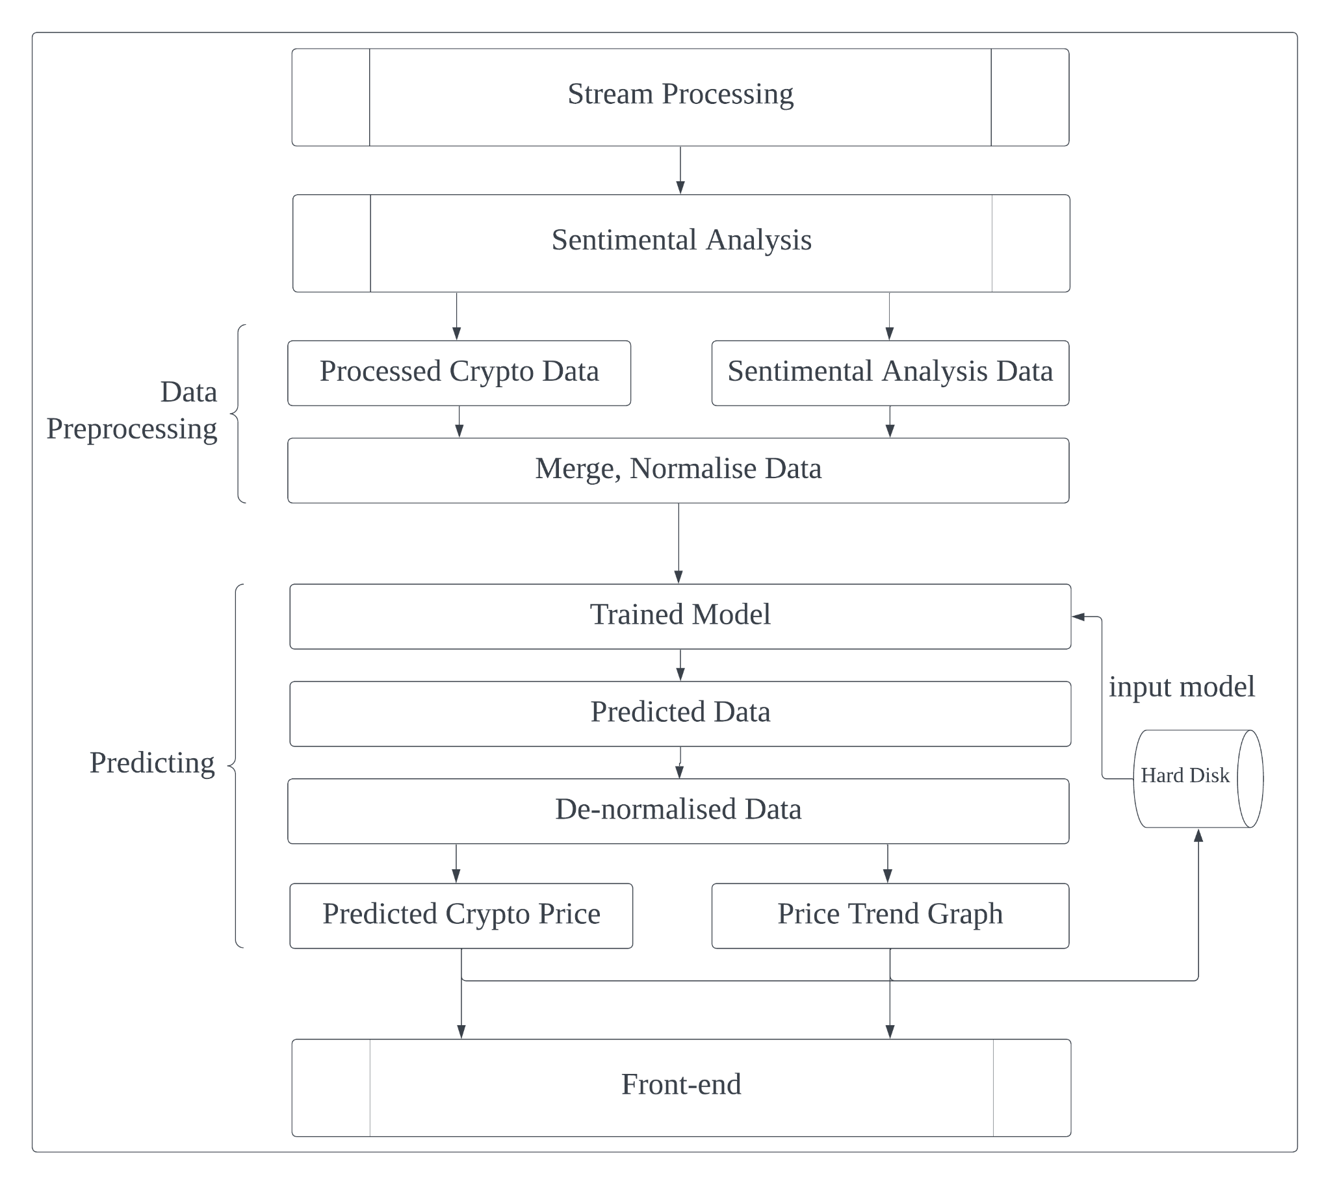
Prediction Model - Prediction
Prediction function is a separate function from the model to join the pipeline of the project.
Avoid train duplicate models
Use exist model file to predict
Input is dataset with window size
Price predicts for the next 1, 3 and 5 days
Output is predicted price and trend graph
Notes:
After trained model, we need to use the model to predict the future price of the crypto currency. The prediction function is a separate function from the training model, which can directly use trained model to predict. In the actual user experience, the user usually expect a quick response from the website, so we let prediction function to join the project pipeline but not the full function containing the training model. The figure on the right hand side is the pipeline of the project which zoom-in on the prediction function. The prediction function load model from the local storage and fetch data set from the previous stage of the pipeline, then output the predicted price and price trend graph to the front-end.

Slide 23
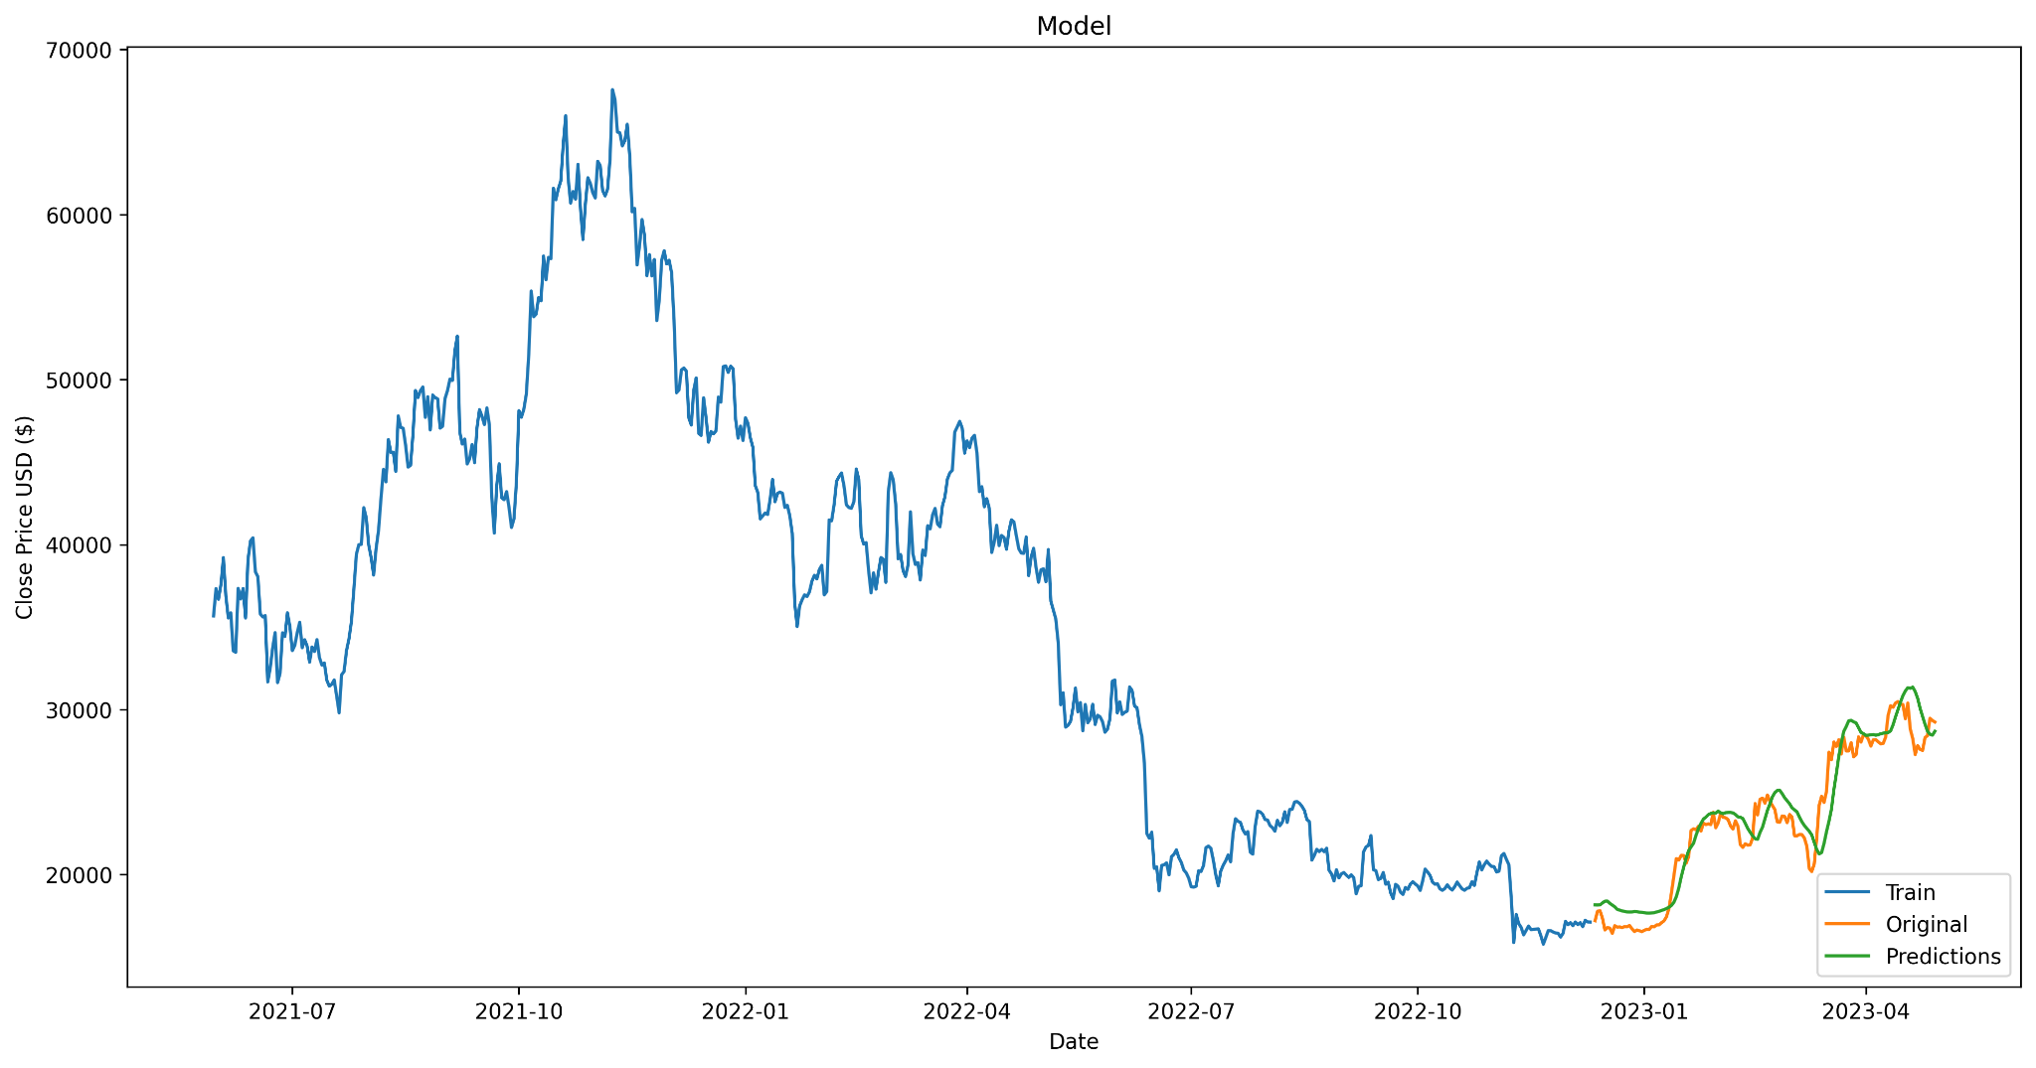
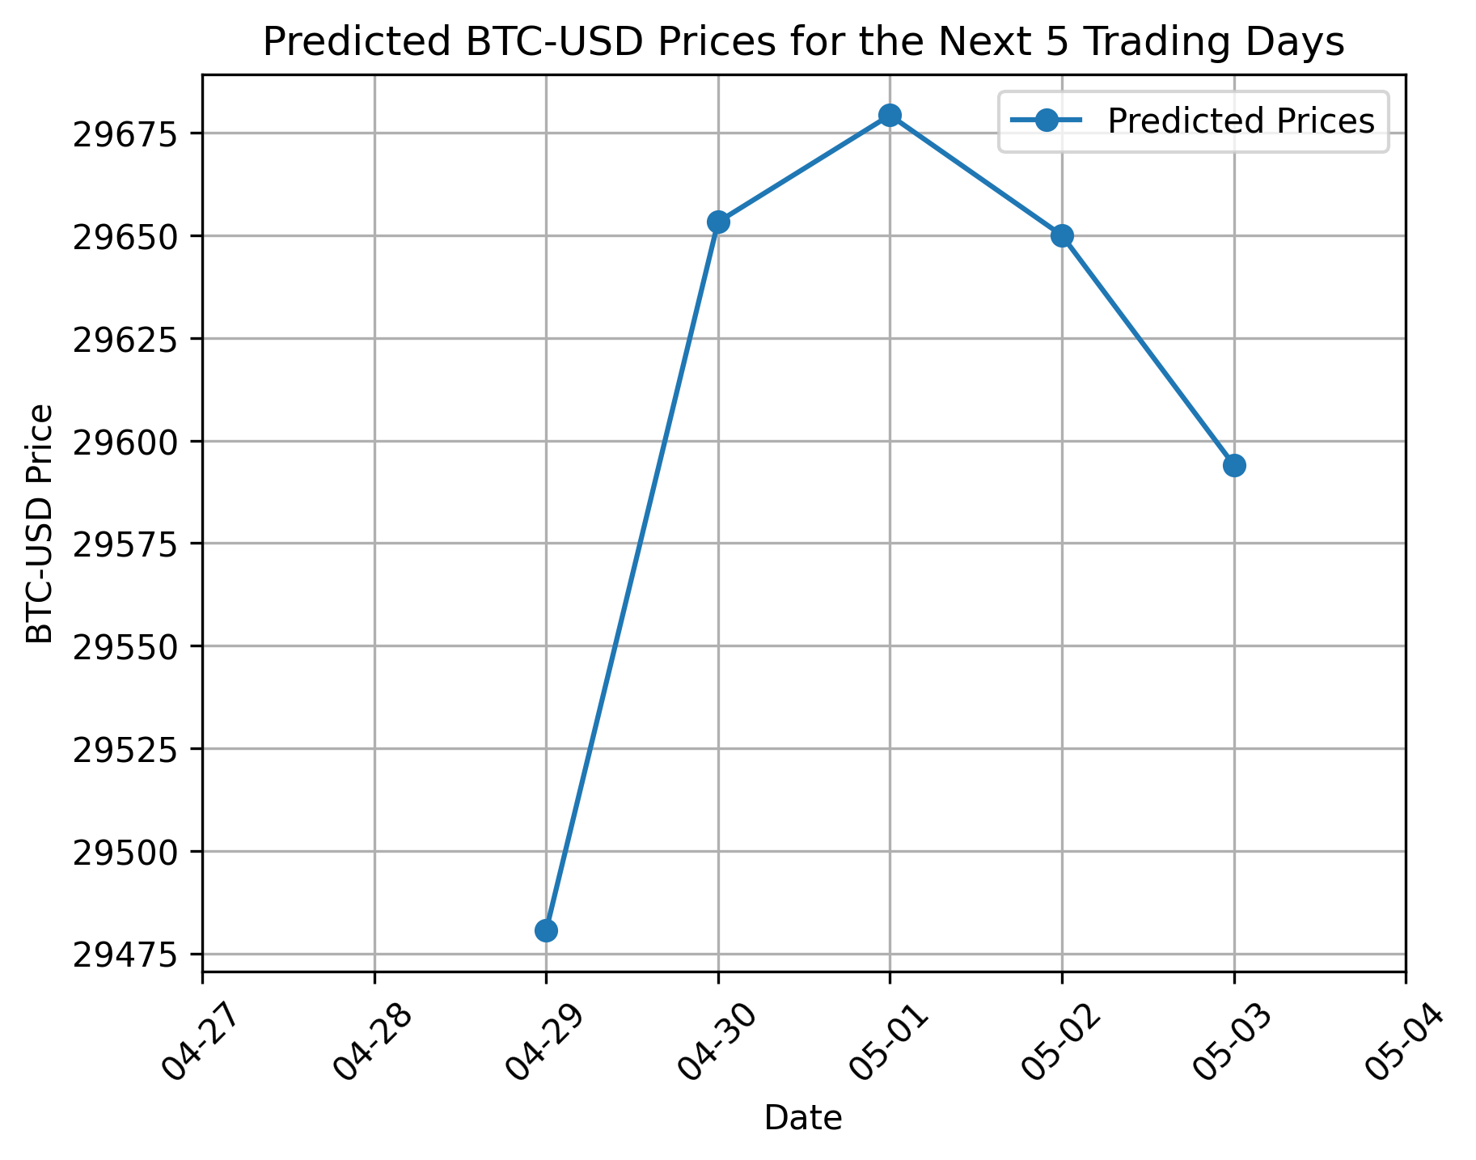
Prediction Model - Result
Accuracy
Prediction price trend
Notes:
The two graph shows the test and prediction result of our model on recent trade days. The left side graph is the test set result, and the right side is the prediction for the future price.

Slide 24
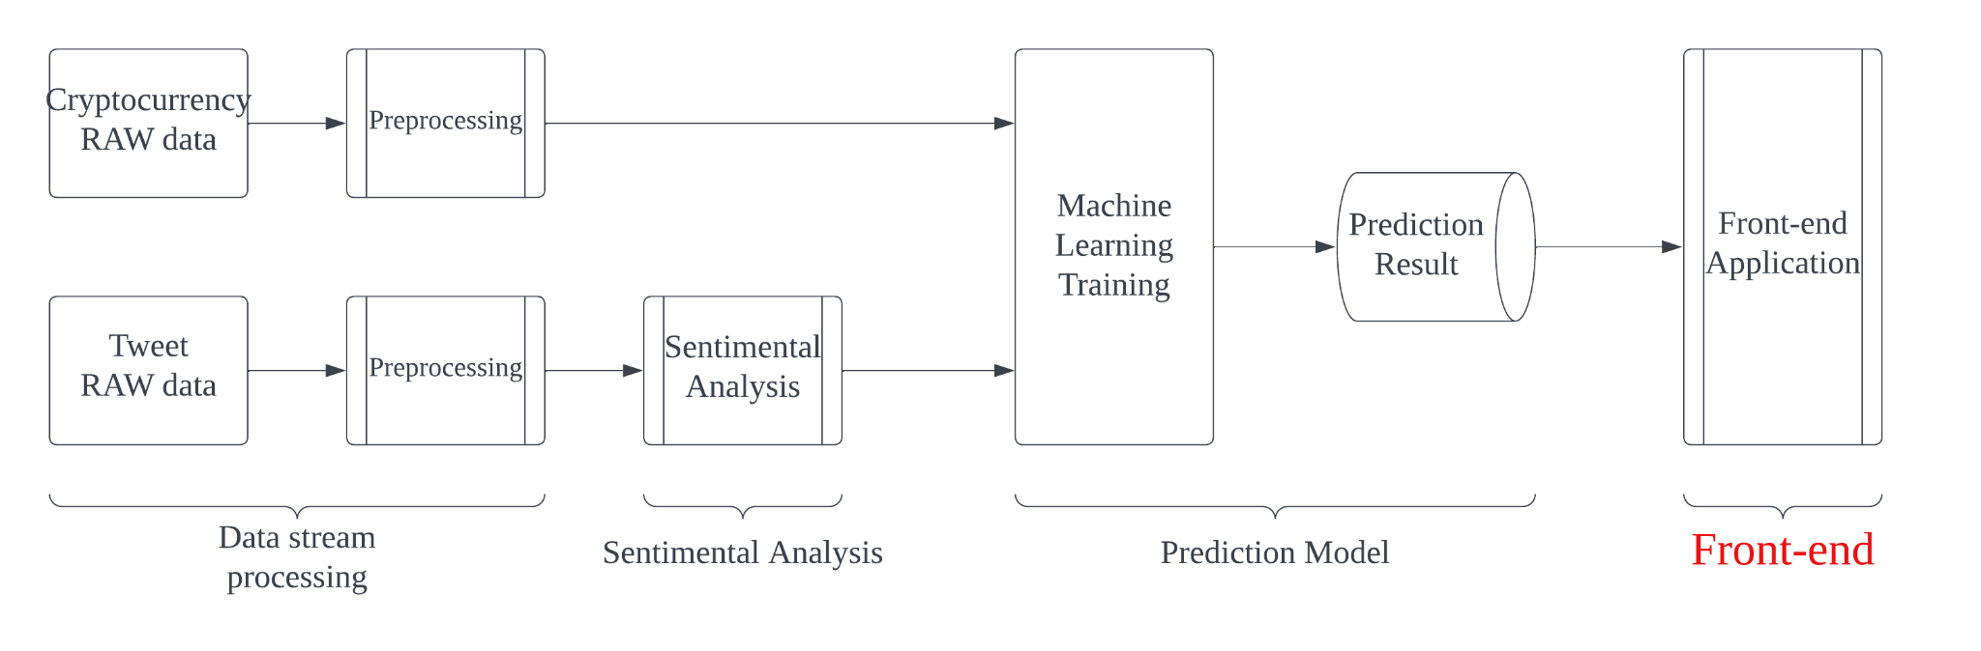
Front-end
React App
Main React components
HomePage
Five Cryptocurrency Page
BTC
ETH
ADA
XRP
DOGE
Notes:
The frontend of this project is built using React and consists of 6 core components, including one HomePage and five cryptocurrency pages. The primary function of the HomePage is to introduce and guide users in selecting a cryptocurrency. Each cryptocurrency page provides users with prediction information specific to the chosen coin.

Slide 25
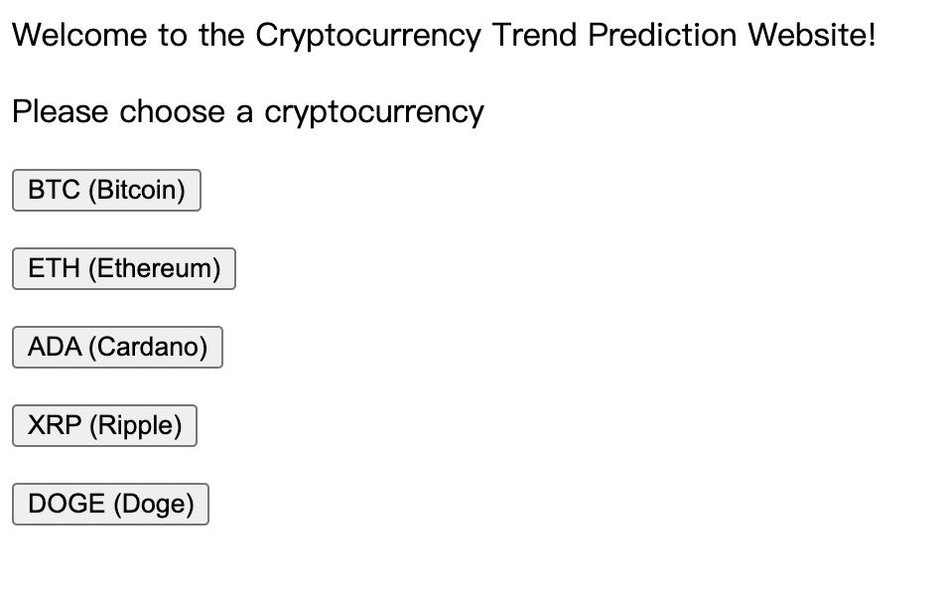
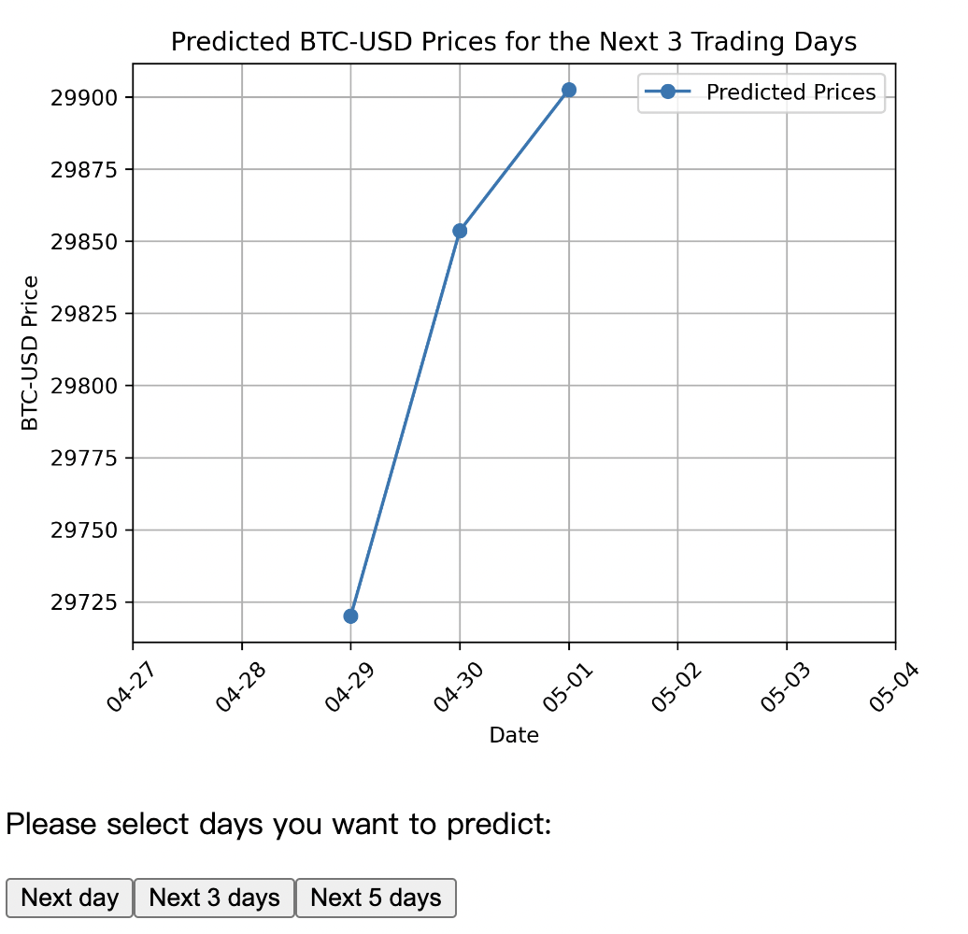
Front-end Example
Notes:
Upon launching the app, users are directed to the HomePage, where they can choose from five of the most popular cryptocurrencies. After making a selection, the app navigates to the respective cryptocurrency page. On each cryptocurrency page, users have the option to predict the price trends for the next 1, 3, or 5 days. Users can also easily return to the HomePage to select a different cryptocurrency.

Slide 26
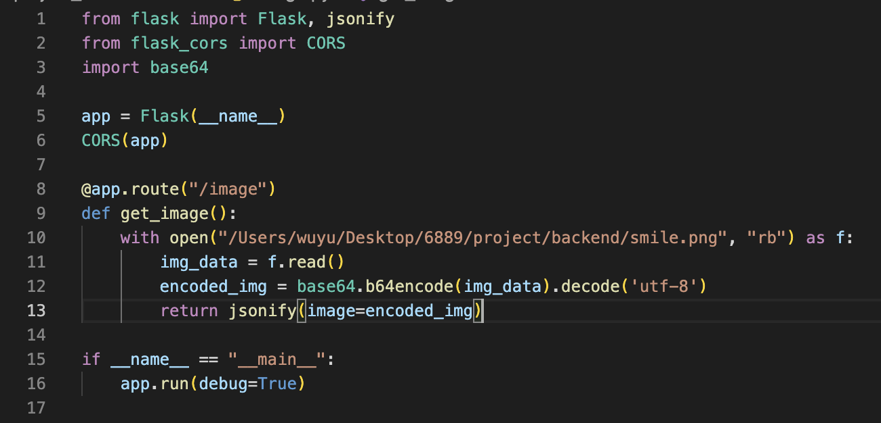
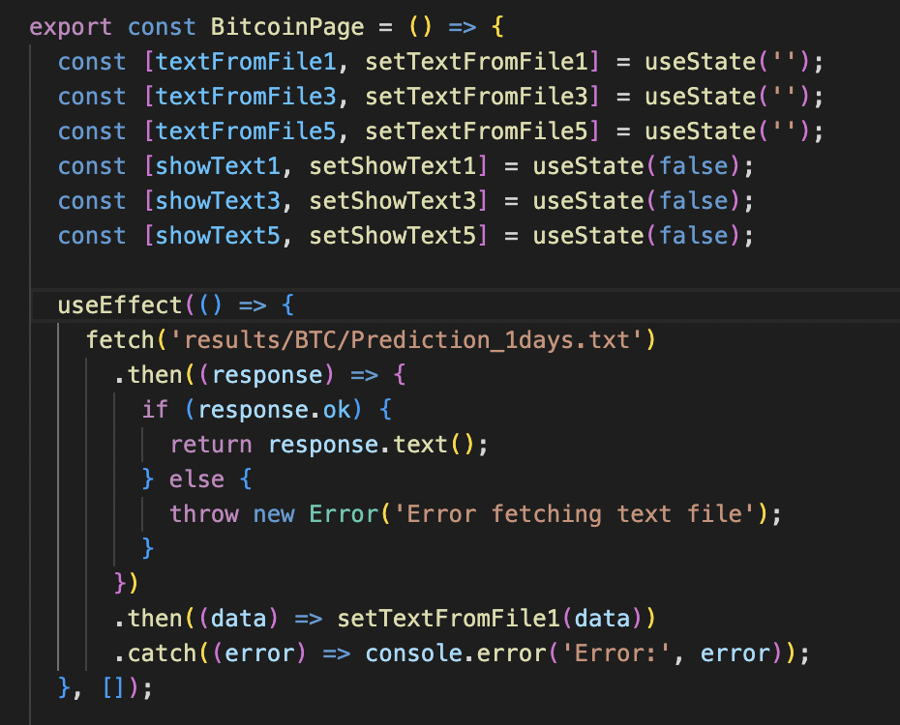
Front-end Connect to Back-end
Notes:
Initially, we used Flask and Axios to serve as the interface between the backend and frontend, with the backend generating trend charts and text in real-time for the frontend. However, this approach had a drawback: the backend had to remain running for users to access the trend information on the frontend. To address this issue, we changed our method by directly saving the backend's predicted trend results as PNG and TXT files in the frontend. We then utilized 'useEffect' to read the TXT data, allowing users to view the trends at any time without requiring the backend to be constantly running.

Slide 27
Project Depolyment
On-line website:
Crontab: run model training daily, including stream processing and sentimental analysis
User click: when user click currency type, prediction function will run to extract predicted price and trend graph to the front-end
Local machine:
Demo
Notes:
We successfully deployed the project on website. We create a crontab to run the training model function daily, including fetch the crypto currency price and sentimental analysis. When user clicks the currency button, the prediction function will run to predict the price and trend graph then plot them on the front end. Next, we will demonstrate our project on the local machine.

Slide 28
Conclusion
In this project, we create and execute a full-pipeline:
Implement spark and optimizations to streaming the data
Use lexicon on sentimental analysis to get the highest accuracy
Construct a LSTM-GRU hyper model to capture the features and predict the price
Extract the price and trend graph to fron-end and plot on the website
Deploy the project on-line, provide automatically processing of the pipeline
Notes:
In general, we create a full pipeline of the project. We use spark and optimizations to streaming the data of crypto currency and tweet data. We use lexicon on sentimental analysis to get the highest accuracy. We use LSTM-GRU hyper model to discover the features of the relationship between two datasets, and predict the future price and price trend. Finally, we plot the prediction result on the front-end, and deploy the full project on-line and provide a full-automatically process of fetch data, analysis, train model and predict the price.

